Slide 1

WOLDIA UNIVERSITY
FACAULTY OF TECHINOLOGY
DEPARTMENT OF COMPUTER SCINCE
Final Project One
Project proposal on: Human Resource Management system for woldia university

Slide 2

Introduction
Now a day most business applications are changed into web based system. Web based system is a system that enables the user to do their works simply, accurately, effectively and efficiently.
Human resource management system is a system that is used to manage human resource and its information available in the organization.
This project is designed to maximize employee’s performance in service of their employer’s strategic objectives.
Since it is automated (web based) it reduces a lot of costs, work over load and it minimizes the space used to store the data and also it provides faster customer service.

Slide 3
Background of Woldia University
Woldia University was established on May 26, 2004. Currently, the total area of the university is 196 hectares of land.
The first batch of students was 599.In its second year of operation, the university admitted over 1457 new students.
Currently, the university has a student population of over 4300. The university is anticipated to contain a student population of 11,000 over a period of five years.
As the number of students and academic branch is increasing the employees who work in the university like teachers and administrative workers is also increase.

Slide 4
Motivation
Even if this project title is selected by the department but we are very interested after we are seeing the working environment.
so, we are very happy to solve their problems. And also the other motivation for us is to fulfill our bachelor degree.

Slide 5
Statement of the problem
Some challenges regarding to the current manual systems are:-
Time consuming
Shortage distribution of information
Lack of accuracy and security
Difficult to manage employee information
Problem of work efficiency
Improper use of resources
Difficulties in record management

Slide 6
Objective
General Objective:
The general objectives of this project is to develop automated human resource management system for Woldia University.
Specific Objective
The specific objectives of our project are:-
To collect requirements.
To analyze and study the existing manual system.
Design the system that will solve the current problems and provide reliable functionalities.
To Study the requirement analysis.
To design the interface.
To implement the proposed system in effective way by Php.

Slide 7
Literature Review
HRMS is done in different universities even in our universities before but they are unable to touch best requirements of the organization, unable to make the system secure, unable to make the system interactive and attractive or user friendly for the end user. May be it comes from time constraints.
HRMS is implemented in different universities like AAU,AASTU. but still their system have problems like the system has not user friendly interface, support only English language. So we are trying to cover those problems

Slide 8
Scope and Limitation of Project
Scopes of the project
Announcement of notice online.
Online Registration of Applicants.
Register and manage the employee profile.
Provide leave employee process.
Support local language.
Register employee training and training event.
Recruiting employee.
Registering new Employee.
Generating report like Human resource report, recruitment report, training report, and other reports will be generated.

Slide 9
Limitation of the project
It is a great trouble for us to get an information about the current manual human resource management system since it helps us what is the working environment looks like. And the other is it is too wide to include all functionality of human resource office due to time constraints.

Slide 10
Methdology
Data gathering techinqe
Interview
We will find information’s from WDU HR office employees by asking different questions. Among the questions here are some:
What kind of system the organization has used?
How the existing manual system works?
What is the duty of the institution workers?
What are the problems of the existing system?
What are the main responsibilities of the organization?
What is the steps to recruit new employees?

Slide 11
Cont.…
Discussion
This is one of the technique in which we have seated together and discussed on the project how we can perform the system. Here we will discuss what jobs of the WDU HR office will be changed in to the system and also we will discuss to find the difficulties in working environment and how to solve or to minimize.

Slide 12
Cont.…
Observation
Observing the real environment is quite important tool to realize the existing problems and business processes.
Documents
We will refer different documents that published by WDU human resource office as well as the university like brochures, and different papers that are posted in the WDU HR office’s wall. And also the existing documents such as forms, guidelines, reports are our main source of data.

Slide 13
System and design tecnology
Object oriented approach
Object oriented analysis allow reusability.
Software complexity managed easily and easily upgraded.
Reduce communication complexity between system developer and client because it allows system developer to design both the static and dynamic part of the system.
Generally object oriented principle (data abstraction, data encapsulation, inheritance and polymorphism) make this method powerful

Slide 14
System development Model
Incremental model
The reason why we use Incremental development is because of those important benefits:
1. The cost of accommodating changing customer requirements is reduced.
2. It is easier to get customer feedback on the development work that has been done.
3. More rapid delivery and deployment.
4. Early increments act as a prototype to help elicit requirements for later increments.
5. Lower risk of overall project failure.
6. The highest priority system services tend to receive the most testing.
7. Error reduction.
8. Incremental resource deployment.

Slide 15
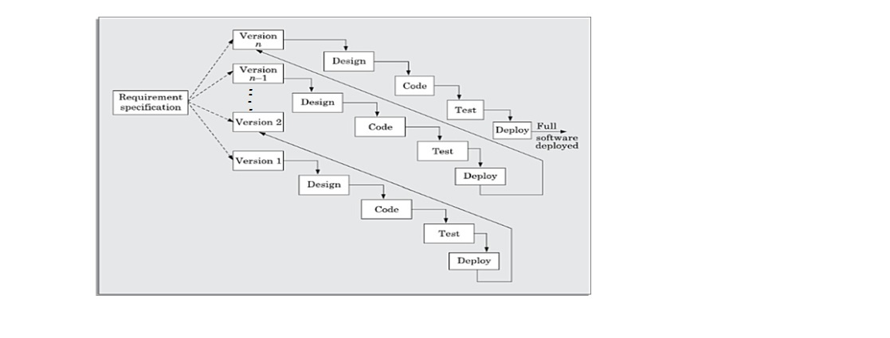
Cont.…

Slide 16
System development tools
Hardware tools
Computer
Data storage like flash, CD, for backup
Software tools
Editor like Notepad, sublime,…
Browser like google chrome, Mozilla Firefox, …
Microsoft word
Microsoft Power point
Edrawmax and Microsoft Visio

Slide 17
Documentation tools
Microsoft Office 2013
Microsoft power point 2013
Microsoft Visio 2013
Edrawmax
Flash disc

Slide 18
Development tool
Php
Apache server
Database namely MySQL
Java script frame works namely jQuery
CSS framework namely bootstrap

Slide 19
Significant of the project
The work load of the employees will be reduced. Search, report, post vacancies,…
Data will be secured for the users.
It will save resources.
Higher speed of retrieval and processing of data.
Giving information to users on Local language (Amharic).
Users will get information and news from the office at anywhere and at any time.

Slide 20
Feasibility of the project
Technical feasibility
At the implementation stage, we should use the latest technology development tools. Such as Bootstrap, PHP, HTML5, and MYSQL and Apache server. Our system can be easily maintain and repair without requiring high Experts or technical supports. As the result our system is technically feasible.
Operational feasibility
Operational feasibility is a measure of how well our proposed system solves the existing manual system’s problem. After automating the system, it addresses basic problems of the organization, particularly employees information can be handled easily, which reduces the work load of staff, thus they feel good.

Slide 21
Cont…
Economical Feasibility
This system is being passed through financial and cost examination. Due to this it has a good benefit categorized under tangible and intangible benefits.
Our proposed system require less people to perform tasks and the propose system process data in short period of time but difficult in existing manual system. Therefore Our system is economically feasible.

Slide 22
Cont.…
Legal Feasibility
After our project is implemented it works in EFDRE constitution as well as in WDU rules and regulation. This means any employees who is not govern for the EFDRE constitution as well as the universities rules and regulation should not be recruit. Due to this our project is legally feasible.

Slide 23
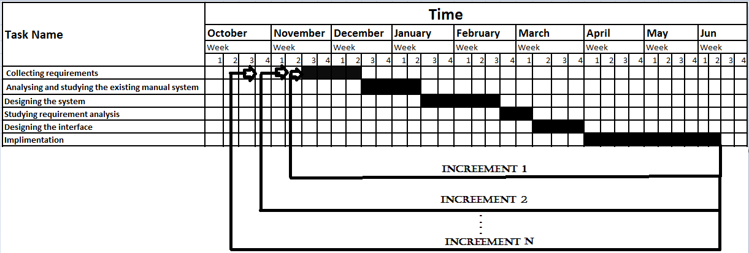
Schedule

Slide 24

Thank you

